Slide 1
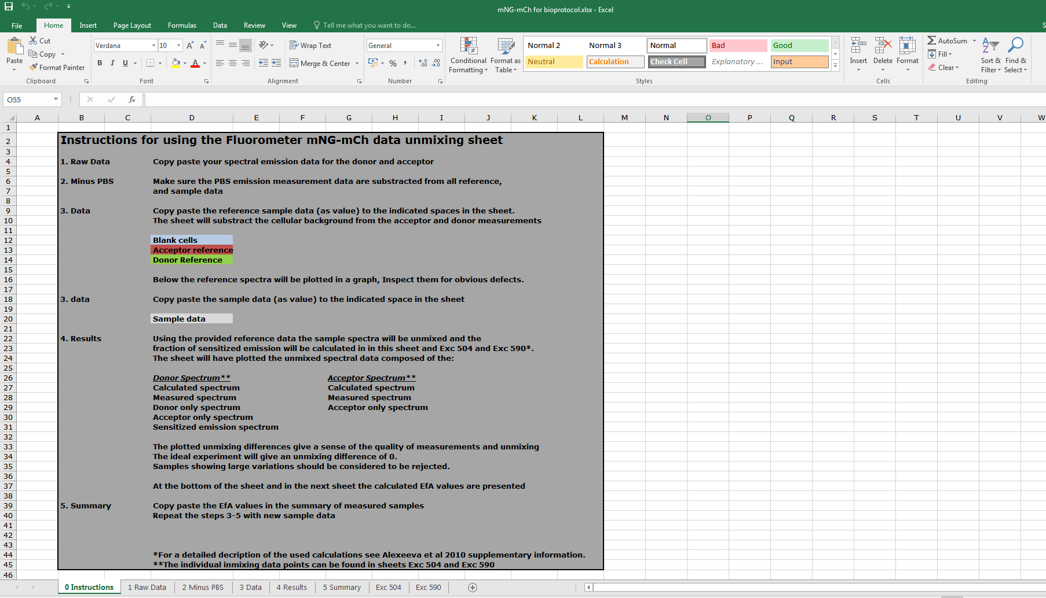
0 - Instructions
Practical instructions for using
the spectral unmixing sheet

Slide 2
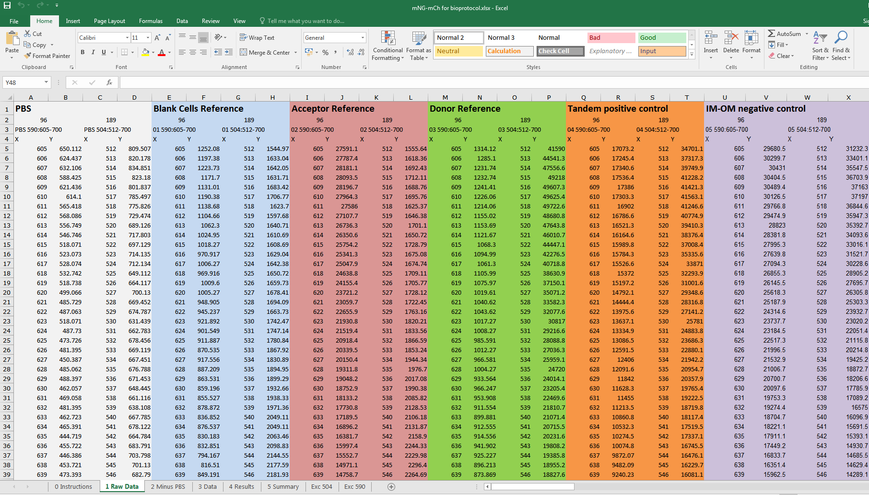
1 – Raw Data
Paste the raw spectral data here

Slide 3
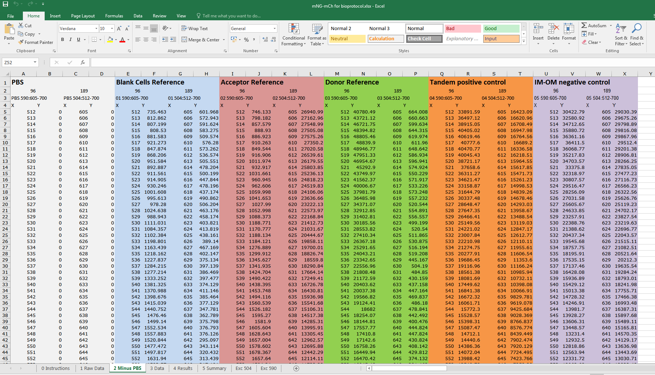
2 – Minus PBS
Substract the PBS background

Slide 4
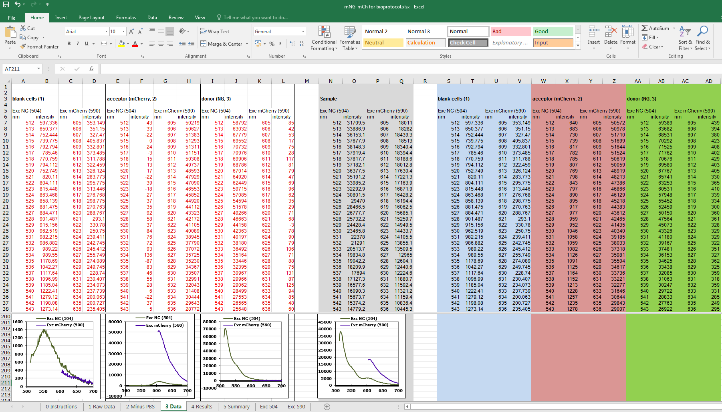
3 – Data
Do not touch the
calculated reference spectra
Paste Sample
spectra here
Paste reference
spectra here
Inspect reference
and sample spectra

Slide 5
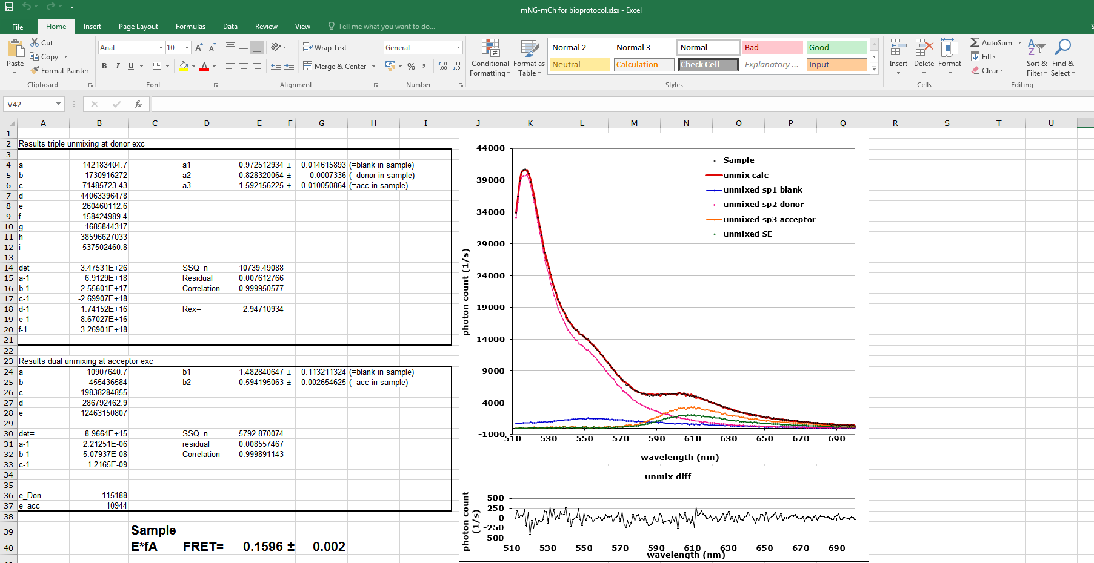
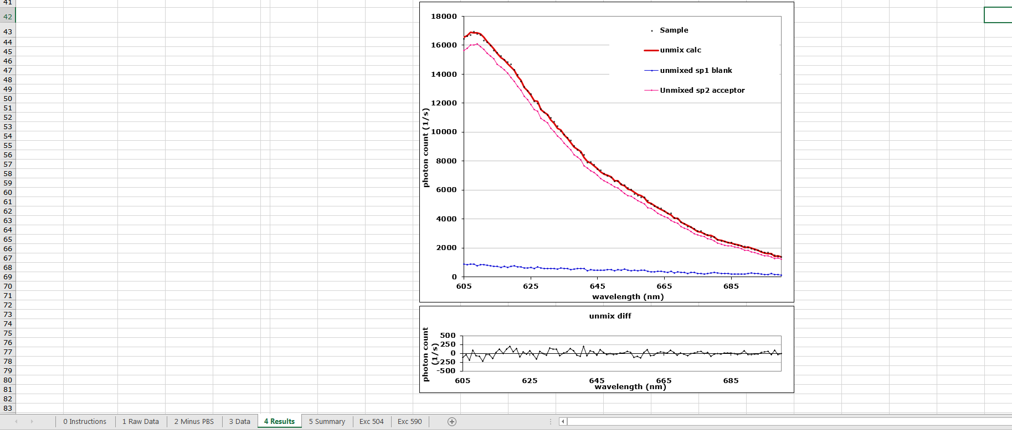
4 – Results
Donor spectrum
Unmixed in
components
Do not touch the
Unmixing parameters
Donor unmixing differences
Acceptor spectrum
Unmixed in
components
Calculated energy transfer
Acceptor unmixing differences

Slide 6
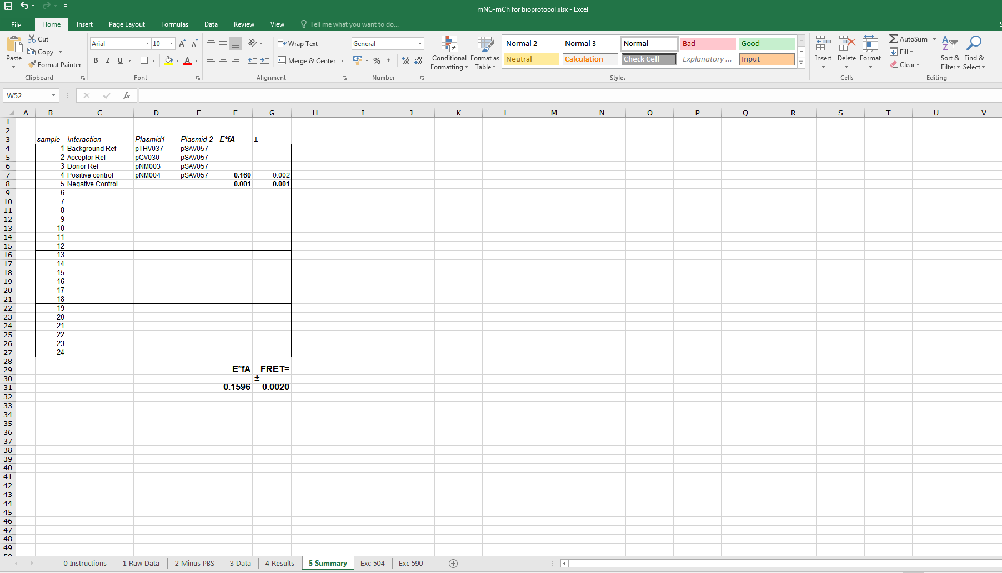
5 – Summary
Copy and paste calculated
energy transfer rates here
Make a list of all samples
and the used constructs
Calculated energy transfer

Slide 7
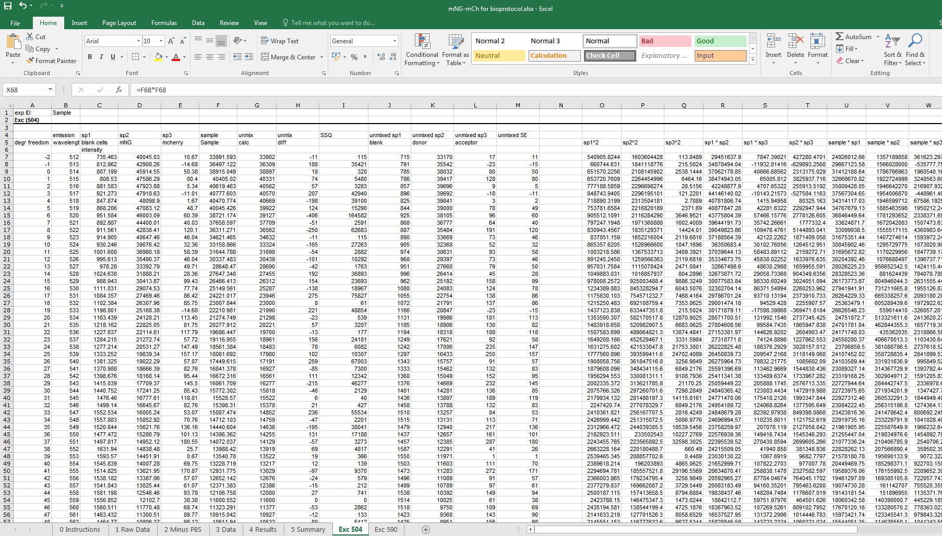
Exc 504
Do not alter the Donor unmixing data
These are the individually unmixed data
(may be usefull for presentation purposes)

Slide 8
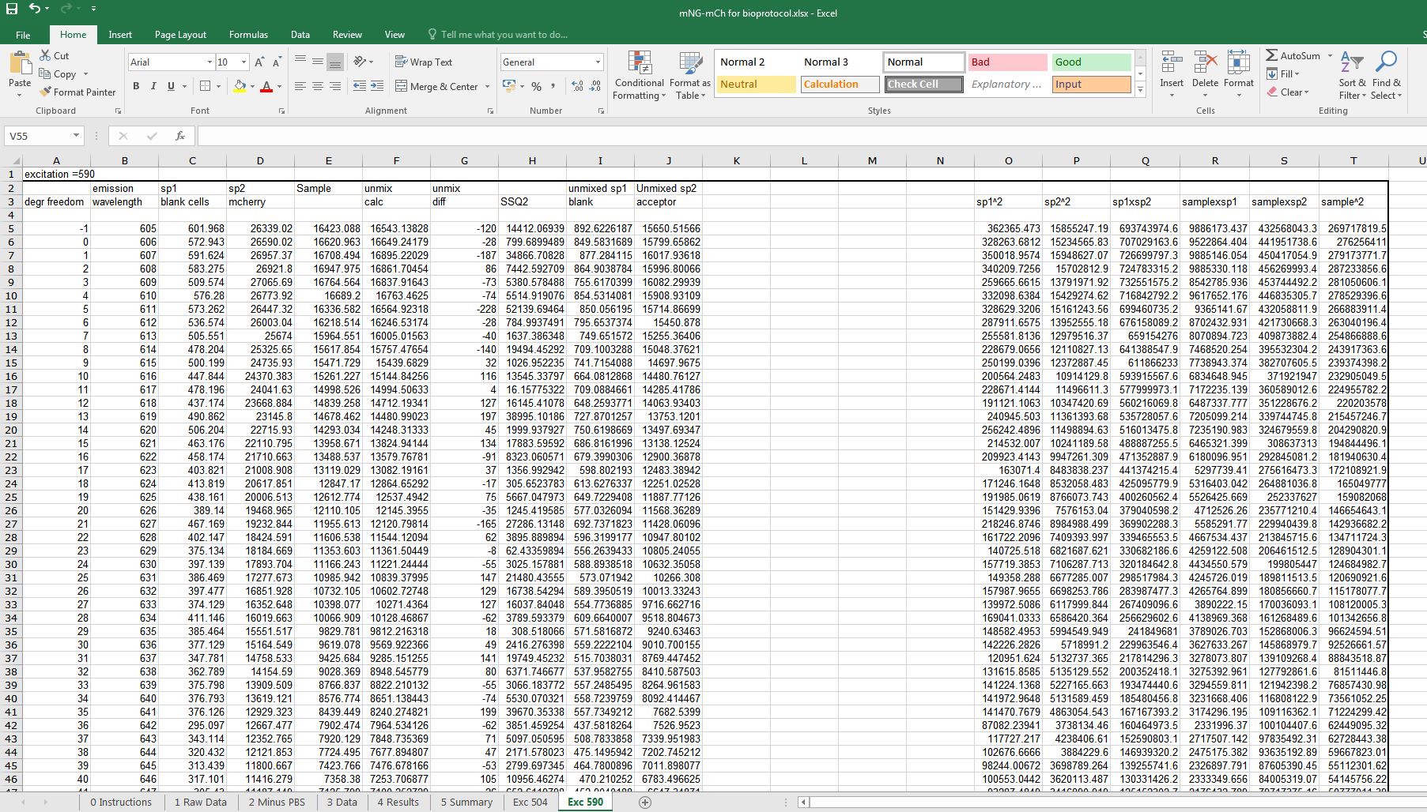
Exc 590
Do not alter the Acceptor unmixing data
These are the individually unmixed data
(may be usefull for presentation purposes)

